Slide 1

Lecture 6
Zeros of Polynomial and Muller Method

Slide 2
Zeros of Polynomials
The Rational Zeros Theorem states:
If P(x) is a polynomial with integer coefficients and if (p/q) is a zero of P(x) (P(p/q) = 0), then p is a factor of the constant term of P(x) and q is a factor of the leading coefficient of P(x).

Slide 3
Steps:
Arrange the polynomial in descending order
Write down all the factors of the constant term. These are all the possible values of p.
Write down all the factors of the leading coefficient. These are all the possible values of q.
Write down all the possible values of . Remember that since factors can be negative, and - must both be included. Simplify each value and cross out any duplicates.
Use synthetic division to determine the values of (p/q) for which P(p/q) = 0. These are all the rational roots of P(x).

Slide 4
Example
Find all the rational zeros of P(x) = x³ -9x + 9 + 2x⁴ -19x².
P(x) = 2x⁴ + x³ -19x² - 9x + 9
Factors of constant term: ±1, ±3, ±9.
Factors of leading coefficient: ±1, ±2.
Possible values of p/q: ±1/1,±1/2, ±3/1,±3/2, ±9/1,±9/2.
These can be simplified to: ±1, ±1/2, ±3,±3/2, ±9,±9/2.

Slide 5
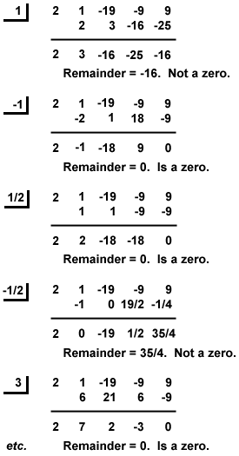
Use synthetic division:
Thus, the rational roots of P(x) are x = - 3, -1,1/2 and 3.

Slide 6
Conventional Methods
Special methods have been developed to find the real and complex roots of polynomials:
Müller method
Bairstow methods

Slide 7
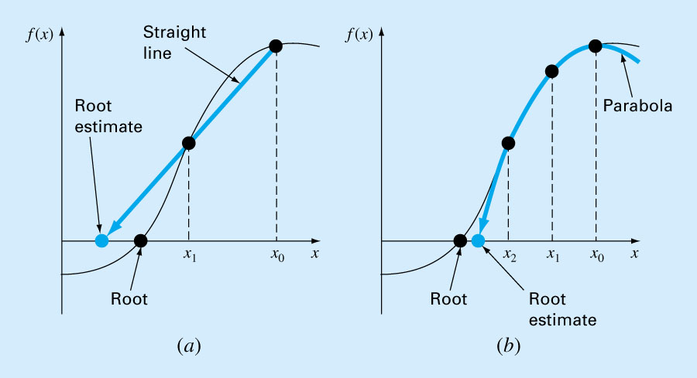
Roots of Polynomials: Müller’s Method
Müller’s method obtains a root estimate by projecting a parabola to the x axis through three function values.
Secant Method
Muller’s Method

Slide 8
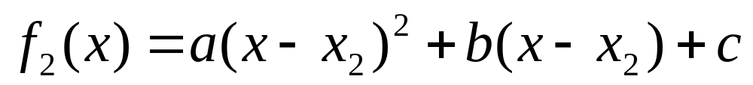
Muller’s Method
The method consists of deriving the coefficients of parabola that goes through the three points:
1. Write the equation in a convenient form:

Slide 9
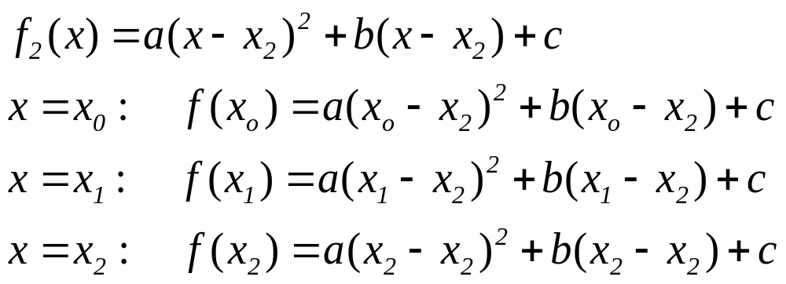
Muller’s Method
2. The parabola should intersect the three points [x_{o}, f(x_{o})], [x₁, f(x₁)], [x₂, f(x₂)].
The coefficients of the polynomial can be estimated by substituting three points to give

Slide 10
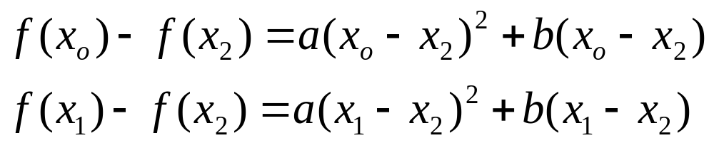
Muller’s Method
3. Three equations can be solved for three unknowns, a, b, c. Since two of the terms in the 3rd equation are zero, it can be immediately solved for c = f(x₂).

Slide 11
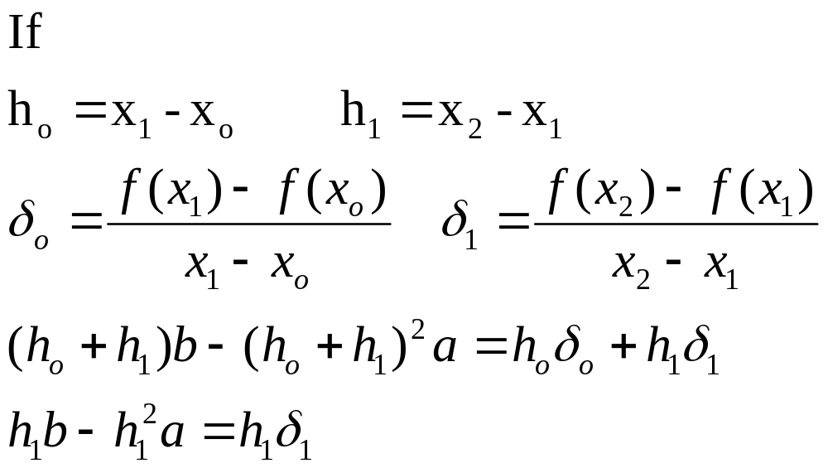
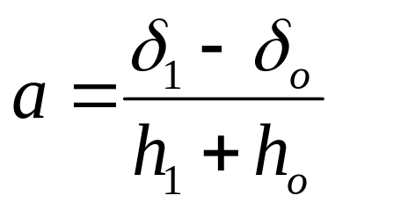
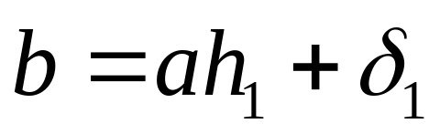
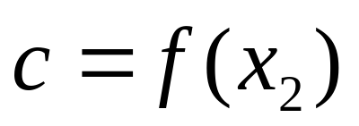
Muller’s Method
Solving the above equations

Slide 12
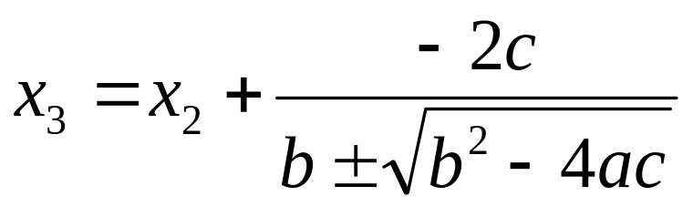
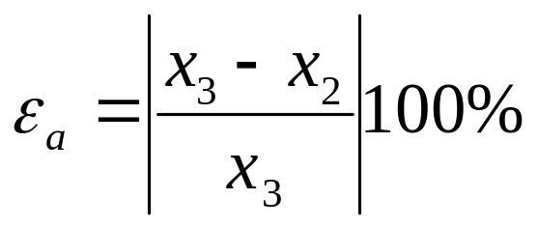
Muller’s Method
Roots can be found by applying an alternative form of quadratic formula:
The error can be calculated as
± term yields two roots. This will result in a largest denominator, and will give root estimate that is closest to x₂.

Slide 13
Muller’s Method: Example
Use Muller’s method to find roots of
f(x)= x³ - 13x - 12
Initial guesses of x₀, x₁, and x₂ of 4.5, 5.5 and 5.0 respectively. (Roots are -3, -1 and 4)
  Solution
  - f(x_{o})= f(4.5)=20.626,
  - f(x₁)= f(5.5)=82.875 and,
  - f(x₂)= f(5)= 48.0
  - h_{o}= 5.5-4.5 = 1, h₁ = 5-5.5 = -0.5
  − δ_{o}= (82.875-20.625) /(5.5-4.5) = 62.25
  − δ₁= (48-82.875)/ (5-5.5) = 69.75

Slide 14
Muller’s Method: Example
  - a = (69.75 - 62.25)/(-0.5+1) = 15
  - b =15(-0.5)+ 69.75 = 62.25
  - c = 48
  ±(b²-4ac)^{0.5} = ±31.54461
  Choose sign similar to the sign of b (+ve)
  x₃ = 5 + (-2)(48)/(62.25+31.54461) = 3.976487
The error estimate is
  ε_{t}=|(-1.023513)/(3.976487)|*100 = 25.7%
The second iteration will have x₀=5.5 x₁=5 and x₂=3.976487

Slide 15
Müller’s Method: Example
Iteration x_{r} Error %
  0 5
  1 3.976487 25.7
  2 4.001 0.614
  3 4.000 0.026
  4 4.000 0.000012

